Slide 1
Character Recognition COS 491
Name: Giouzakov Konstantinos

Slide 2
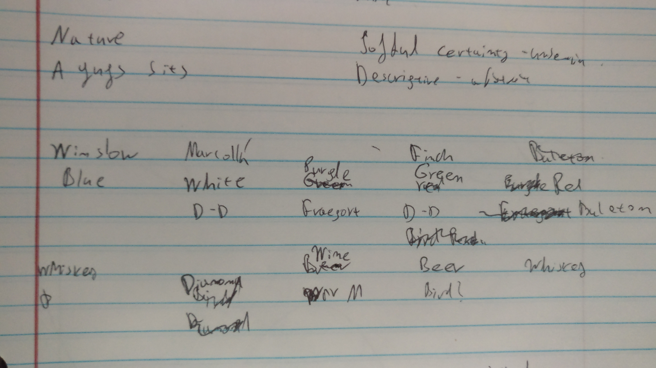
Motivation

Slide 3
Description
The aim is to create a character recognition software, which, potentially, can be upgraded further into a ‘Hand Writing Recognition’ program.
The software should be able to convert an imaged sentence into a text string.
The software should be able to become better (ML).

Slide 4
Requirements
Functional:
Supervised Machine Learning
Accuracy in Predictions
Scalable Improvement
Non Functional:
Efficiency
Adaptability
Robustness
Testability
Cost

Slide 5



Technologies Used

Slide 6
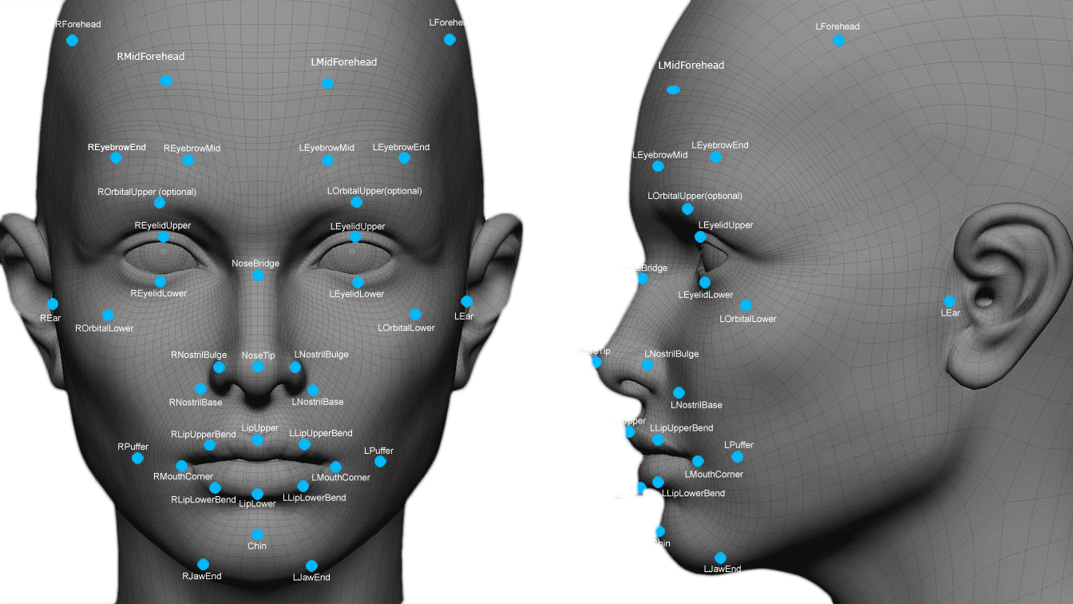
Open CV
Open CV is a library designed for image manipulation and Contour Detection.
Using the Contour approach, it’s possible to detect elements on the screen.

Slide 7
Software Design Architecture
Training
Future Implementations
Classification Data
CR
Library
Test File
KNN Algorithm

Slide 8
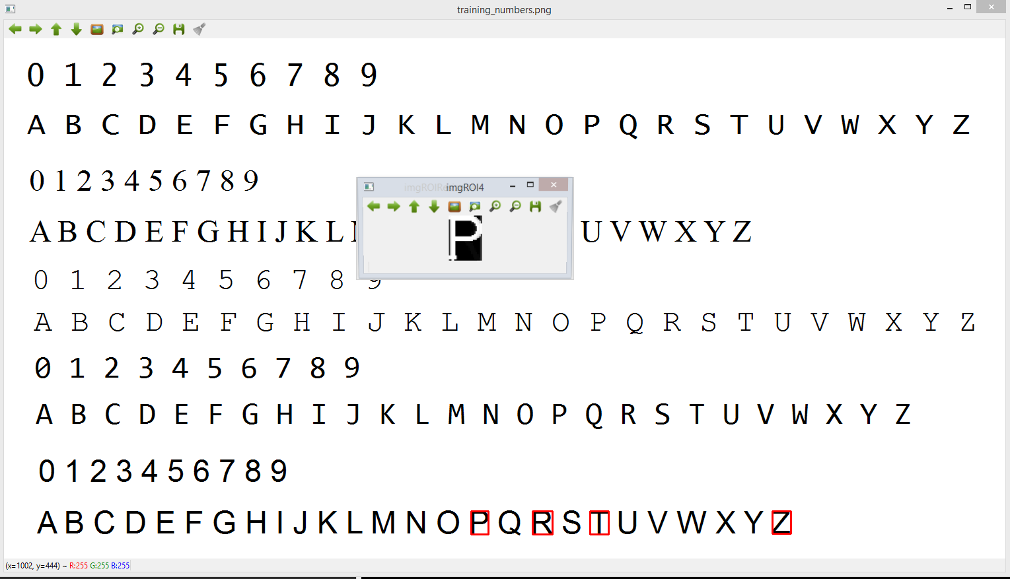
Training Part
Resized Imaged: 20x30 → 600 px

Slide 9
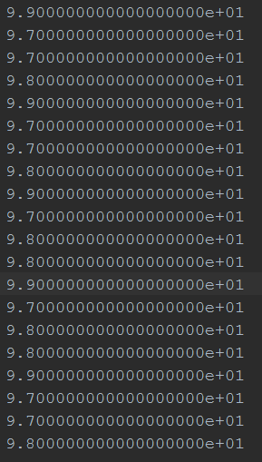
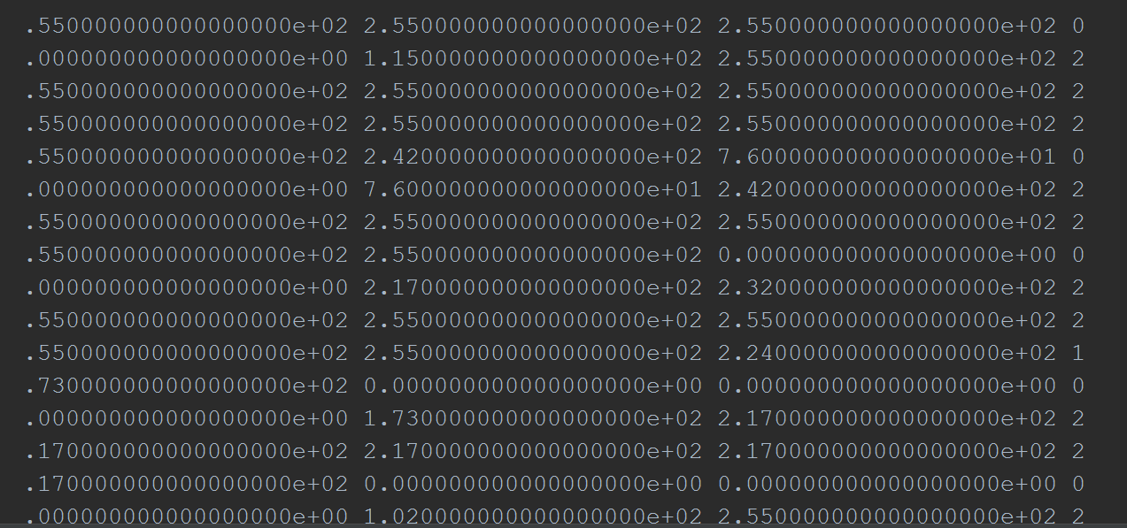
Classification Data
Resized Imaged: 20x30 → 600 px
Class
Flattened Image

Slide 10
Software Design Architecture
Training
Future Implementations
Classification Data
CR
Library
Test File
KNN Algorithm

Slide 11
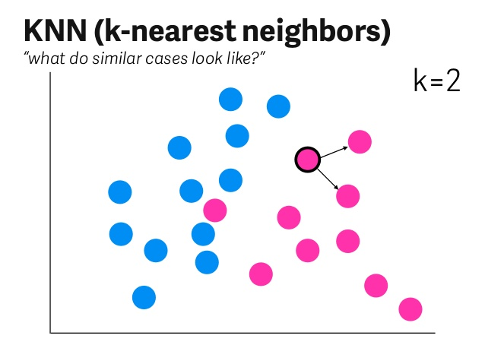
KNN: K-Nearest Neighbors

Slide 12
Software Design Architecture
Training
Future Implementations
Classification Data
CR
Library
Test File
KNN Algorithm

Slide 13
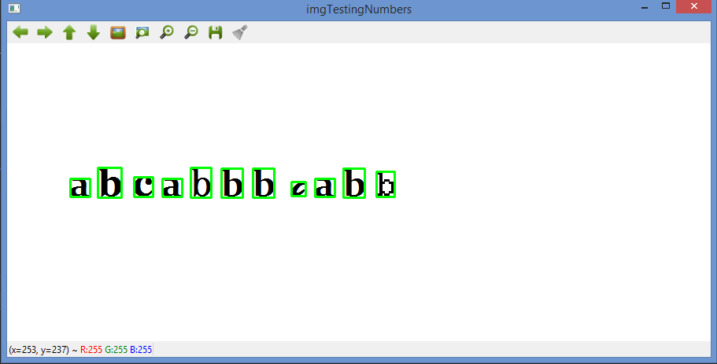
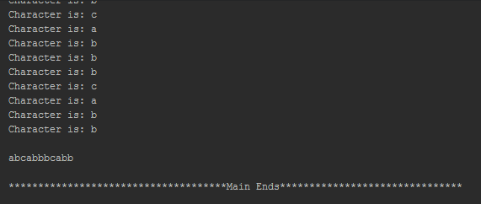
Testing

Slide 14
Thank You For Your Time

